Slide 1
Eclipse IDE
Sarower Ahmmed

Slide 2
The initial codebase originated from IBM VisualAge
Eclipse is a IDE (Integrated developmental tool)

Slide 3
IDE(Integrated development environment)
Help to download all necessary thing in one tool
Help to write programing language
Help to add all liberty files
Also help to compile code with JAVA library

Slide 4
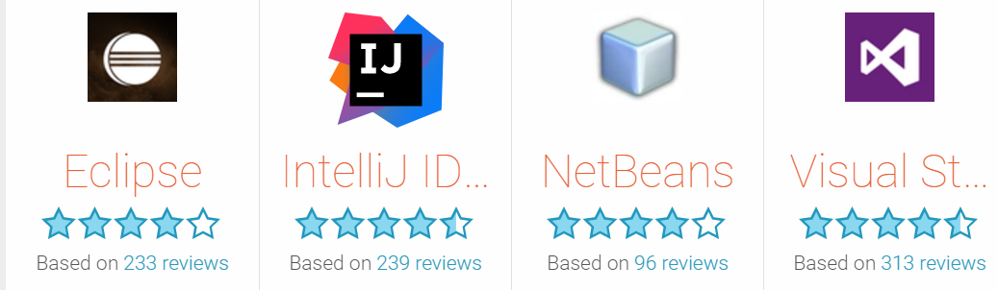


IDE in market

Slide 5
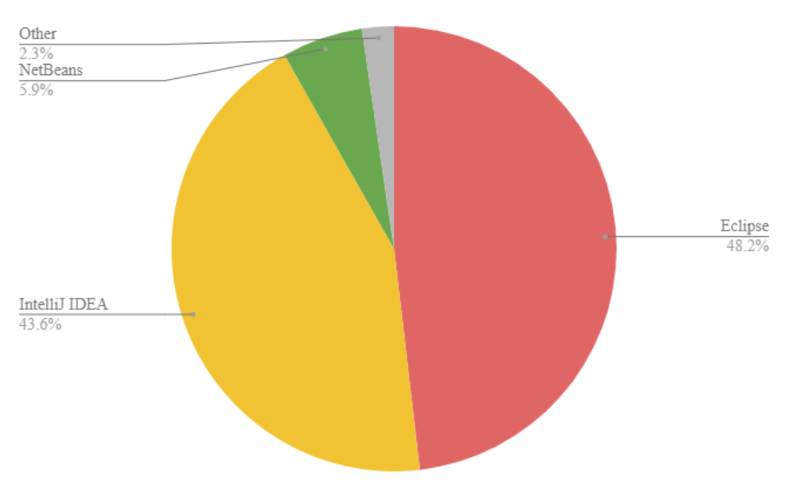

Slide 6
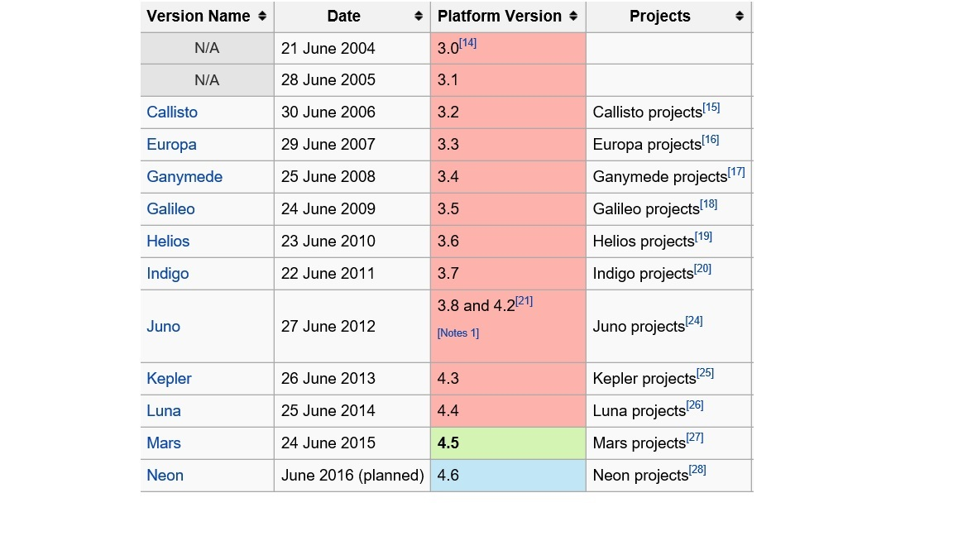
Integrated Firefox 8 support
4.7 (Oxygen) / 28 June 2017; 38 days ago (2017-06-28)

Slide 7
JAVA Project Structure in Eclipse
Your company project name
Create java/ Maven Project
Create package(group of Class)
Create Class
Create methods
Create Variable
Implement java OOPs concept in coding
By Java

Slide 8
Naming convention in JAVA
Java naming convention is a rule to follow as you decide what to name your identifiers such as
class,
package,
Variable or constant,
method etc.
But, it is not forced to follow. So, it is known as convention not rule.

Slide 9
Name | Convention
class name | should start with uppercase letter and be a noun e.g. String, Color, Button, System, Thread etc.
interface name | should start with uppercase letter and be an adjective e.g. Runnable, Remote, ActionListener etc.
method name | should start with lowercase letter and be a verb e.g. actionPerformed(), main(), print(), println() etc.
variable name | should start with lowercase letter e.g. firstName, orderNumber etc.
package name | should be in lowercase letter e.g. java, lang, sql, util etc.
constants name | should be in uppercase letter. e.g. RED, YELLOW, MAX_PRIORITY etc.

Slide 10
Project | Package | Class | Method | Variable
Camel Case | Lower case | Camel Case | Camel Case | Camel Case
1st letter Upper | 1st letter lower | 1st letter Upper | 1st letter lower | 1st letter lower
No space permitted | No space permitted | No space permitted | No space permitted | No space permitted
Use _ for space | Use . For space | Use _ for space | Use _ for space | Use _ for space

Slide 11
Project
Need to create project 1st
Name Same as your company Project Name
My Current Project: Liquidity Risk management
Eclipse Project: Liquidity Risk management Selenium Automation

Slide 12
Source Folder
Simple java project only have one source folder: src
Maven project has 4 source folder:
src/main:
src/main/resources- cucumber feature file
src/main/java- java framework supporting code will be here
src/test:
src/test/java- all test code will be write and run from here
JVM knows it is the area where all test code
JVM compile or rum all code inside this folder
Src/test/resources- all test related data will be here

Slide 13
Package name
Naming Conventions
Package names are written in all lower case to avoid conflict with the names of classes or interfaces.
Companies use their reversed Internet domain name to begin their package names—for example, com.example.mypackage for a package named mypackage created by a programmer at example.com.
Name collisions that occur within a single company need to be handled by convention within that company, perhaps by including the region or the project name after the company name (for example, com.example.region.mypackage).
Packages in the Java language itself begin with java. or javax.

Slide 14
Write 1st java CODE and print it
Hello World

Slide 15
What is Build
A build is only a portion of the software;
while a Release encompasses the entirety/part of the software as originally designed

Slide 16
THANKS

